Slide 1

RUNGTA COLLEGE OF DENTAL SCIENCES & RESEARCH
TITLE OF THE TOPIC-
MANAGEMENT OF CROSS BITE
DEPARTMENT OF ORTHODONTICS AND DENTOFACIAL ORTHOPAEDICS

Slide 2
Specific learning Objectives
CORE AREAS | DOMAIN | CATEGORY
DEFINITION | AFFECTIVE | NICE TO KNOW
ETIOLOGY | AFFECTIVE | NICE TO KNOW
CLASSIFICATION | COGNITIVE | MUST KNOW
CLINICAL FEATURES | COGNITIVE | NICE TO KNOW
DIAGNOSIS | COGNITIVE | MUST KNOW
MANAGEMENT | PSYCHOMOTOR | MUST KNOW

Slide 3
CONTENTS
Definition
Etiology
Classification
Clinical Features
Diagnosis
Management

Slide 4
DEFINITION:
According to Graber:
Cross bite is a condition where one or more teeth may be abnormally malposed buccal or lingually or labially with reference to opposing teeth.

Slide 5

Etiology of cross bite
Etiology of Anterior cross bite | Etiology of posterior cross bite
[I] Dental Causes
Traumatic injury to primary dentition that causes a lingual displacement of permanent tooth bud. Persistance of a deciduous tooth Palatal deflection of its erupting successor Single tooth anterior cross bite Super numerary tooth. A habit of biting the upper lip Cleft lip repair cases Arch length inadequacy Causing lingual deflection of permanent tooth during eruption. | Prolonged retention of primary tooth. Ectopic eruption of the permanent first molar. Prolonged thumb or finger sucking. Cleft palate cases.

Slide 6
Etiology of Anterior cross bite | Etiology of posterior cross bite
[II] Skeletal Causes
Genetic. Due to deficient anterior growth of maxilla Excessive abnormal mandibular growth in anteriorly. Combination of both 2. & 3. | Genetic. Due to deficient lateral growth of maxilla. Eg. In cleft palate cases se Stimulation in mid palatal suture se Lateral maxillary growth Excessive abnormal mandibular growth laterally. Combination of both 2. & 3.

Slide 7
Etiology of Anterior cross bite | Etiology of Posterior cross bite
[III] Functional Cross bite
Pseudo class III Habitual forward positioning of the mandible to obtain maximum intercuspation may lead to an anterior cross bite. | Unilateral posterior cross bite Due to occlusal interferences Deviation of mandible during jaw closure

Slide 8
CLASSIFICATION
[I] Based on Location
Cross bite
ANTERIOR CROSS BITE
POSTERIOR CROSS BITE
a. According to no. of teeth involved
a. According to no. of teeth involved
Single tooth
Cross bite
Segmental
Cross bite
Single tooth
Cross bite
Segmental
Cross bite
b. According to side involved
Unilateral
Bilateral
c. According to extent
Single posture
Cross bite
Buccal
Non-occlusion
Lingual
Non-occlusion

Slide 9
[II] Based on the Etiologic Factor
Cross bite
Skeletal
Crossbite
Dental
Crossbite
Functional
Crossbite

Slide 10
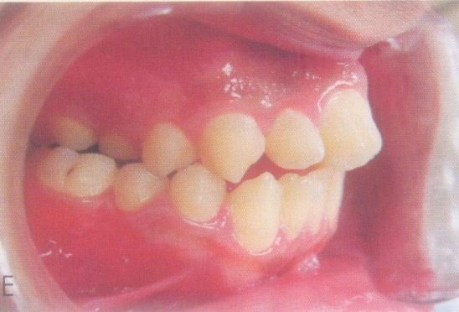
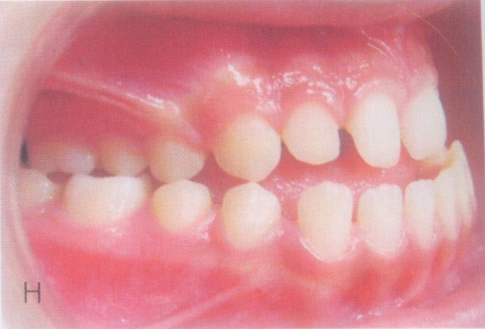
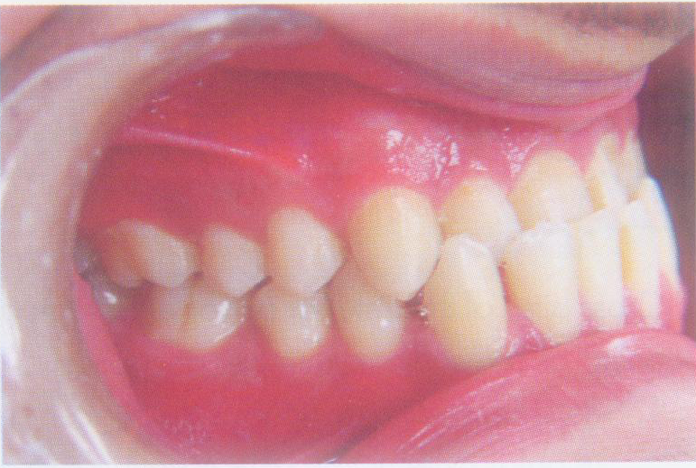
Clinical Features
Anterior cross bite
Posterior cross bite
An abnormal labiolingual relationship (reverse overjet) between one or more maxilary and mandibular anterior teeth.
An abnormal buccolingnal relationship of teeth in the maxilla and mandible when the 2 dental arches are brought into Centric Occlusion.

Slide 11
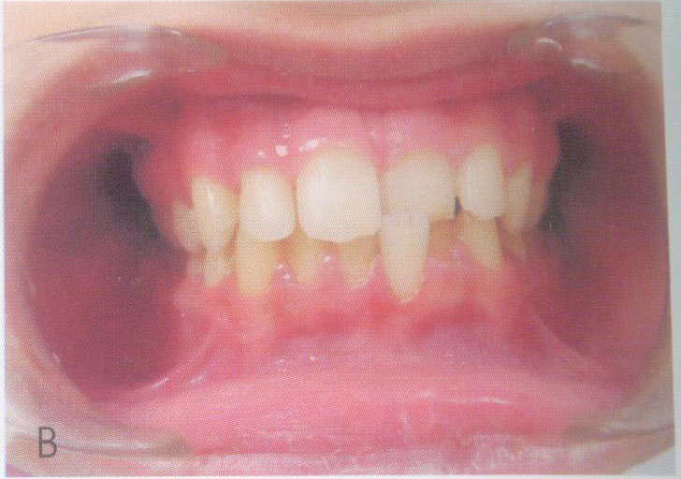
Single tooth crossbite
Segmental crossbite
Involve only single tooth
Involve a segment of arch

Slide 12
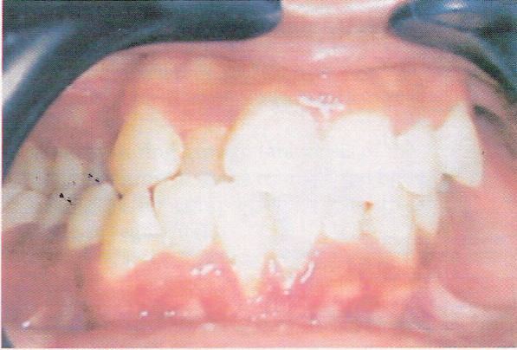
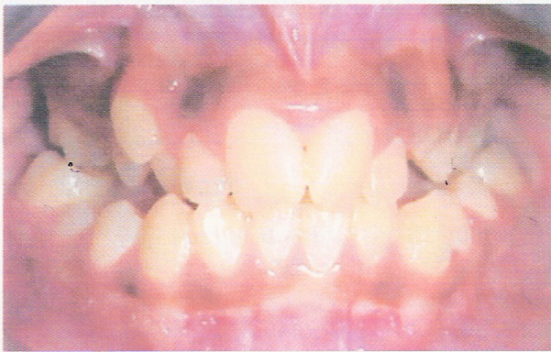
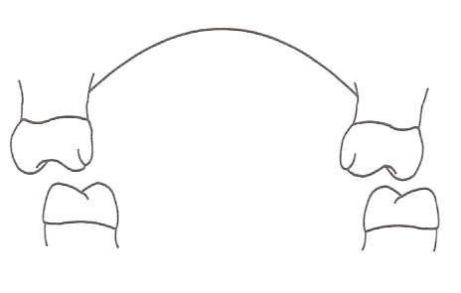
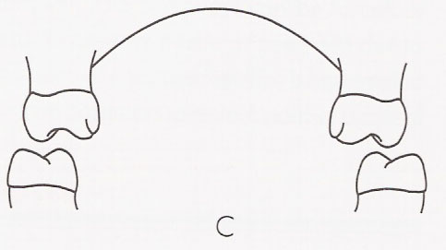
Unilateral cross bite
Bilateral cross bite
Involving and side of arch
Involving both side of arch

Slide 13

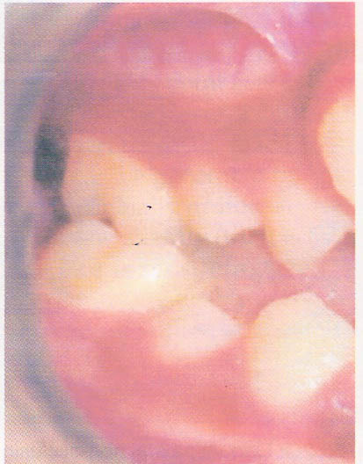
Simple posterior crossbite
Seen most frequently in clinical practice
buccal cusp of one or more maxillary posterior teeth occlude lingual to the buccal cusps of the mandibular teeth.

Slide 14

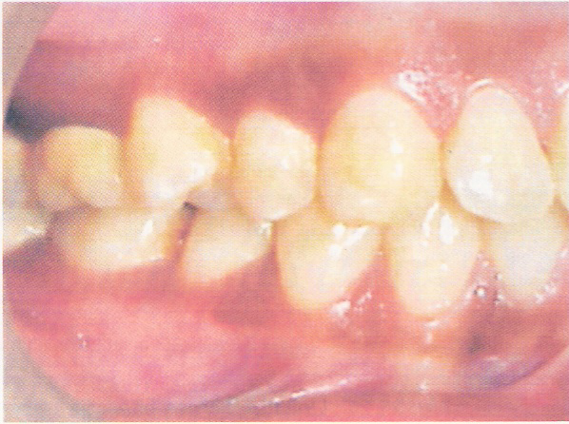
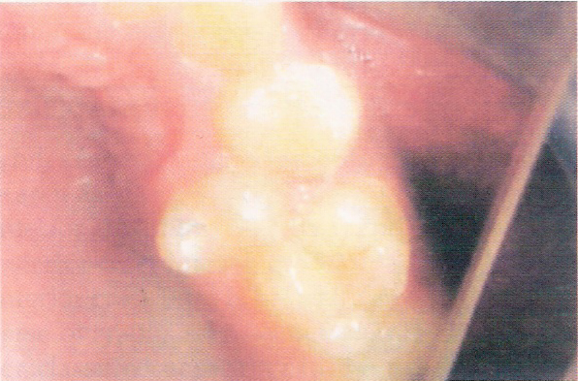
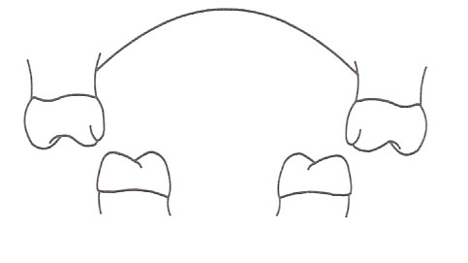
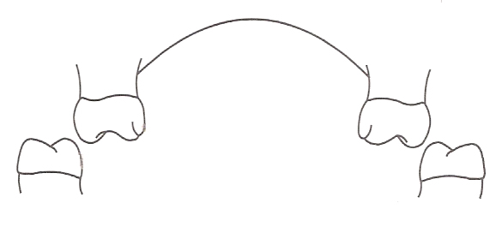
Buccal Non-occlusion (Scissors bite)
- Maxillary posterior teeth occlude entirely on the buccal aspect of the mandibular posteriors.
Palatal/Lingual Non-occlusion
- Maxillary posterior occlude entirely on the lingual aspect of the mandibular posterior.

Slide 15
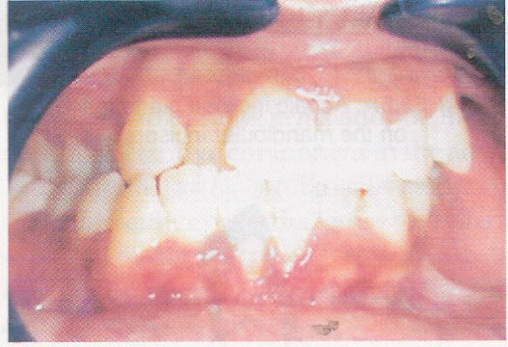
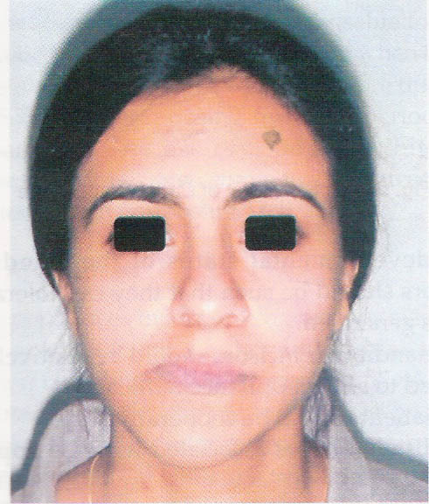
Skeletal cross bite
Discrepancy in the size of maxilla & mandible.
Causes :-
Inherited
Defective embryological development.

Slide 16

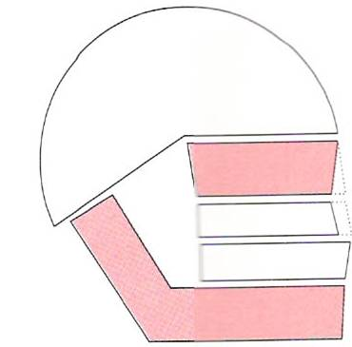
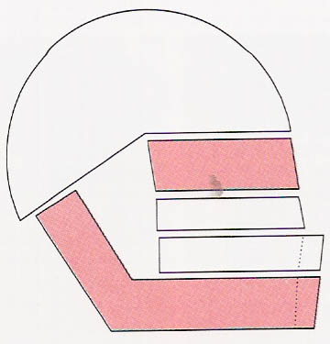
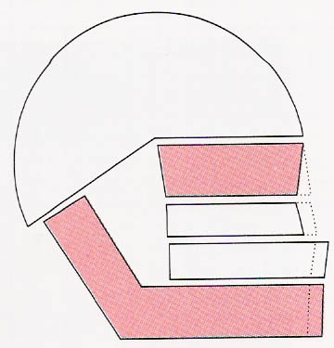
Anterior crossbite due to maxillary retrognathism.
Anterior crossbite due to mandibular prognathism.
Anterior crossbite due to maxillary retrognathism and mandibular prognathism.

Slide 17
Dental cross bite:
Causes of anterior dental cross bite
Lingual eruption path of maxillary anterior teeth.
2. Trauma to deciduous dentition in which there is displacement of tooth buds
Retained deciduous causing lingual eruption of permanent teeth.
4. Supernumerary teeth.
Functional Cross bite:
Habitual forward positioning of mandible may lead to an anterior crossbite (pseudo class III).
An acquired muscular reflex pattern during closure of mandible is involved in functional crossbite.

Slide 18
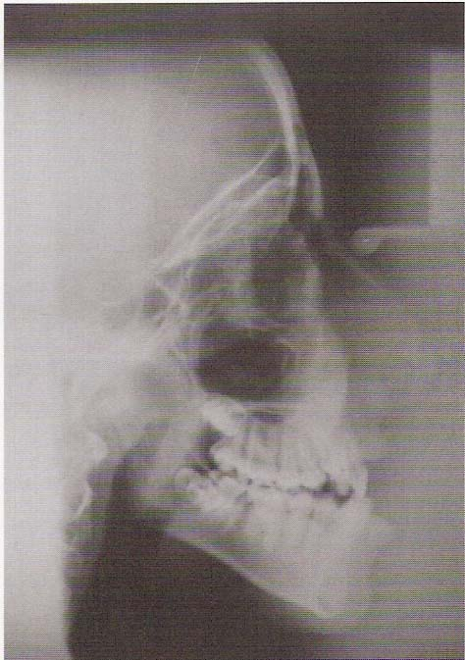
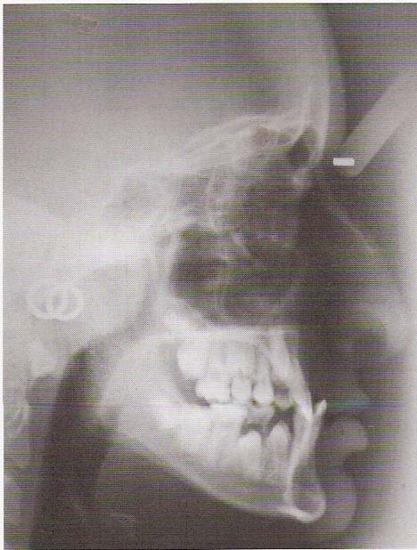
DIAGNOSIS
History
Clinical Examination
Study Models
Radiograph
Lateral cephalogram (for anterior cross bite)
PA view of cephalogram (for posterior cross bite)
Patient with anterior skeletal cross bite (Lateral cephalogram)

Slide 19
[A] MANAGEMENT OF ANTERIOR CROSSBITE
In 4 stages
[I] In primary dentition
[II] In mixed dentition
[III] In permanent dentition
[IV] In post permanent dentition

Slide 20
Factors influencing treatment of anterior crossbite
Overbite
Space
Type of tooth movement
Maxillary incisor torque
Functional shift on closure of mandible
Number of teeth in crossbite

Slide 21
[I] IN PRIMARY DENTITION:
(Preventive orthodontic)
Elimination of the factors that may lead to the anterior cross bite
Eg –
Removal of occlusal prematurities
Extraction of supernumerary tooth before they cause displacement of other tooth.
Habit breaking appliance.

Slide 22
[II] IN MIXED DENTITION:
Interceptive orthodontics
(In pre-adolescent age group)
Anterior cross bite should be treated at an early stage.
Because
If a cross bite present in the deciduous dentition, it may manifest in the mixed & permanent dentition as well.
If a simple anterior cross bite is not treated in early stage
It may progress into skeleton malocclusion that later need complicated orthodontic treatment or surgical treatment.

Slide 23
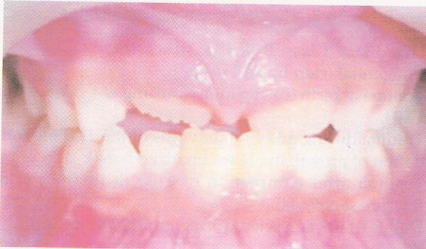
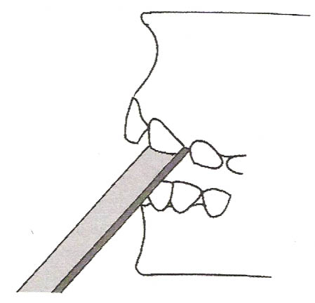
(1) Use of tongue blade
Indications
Used when a cross bite is seen at the time the permanent teeth are making an appearance in the oral cavity.
It is placed inside the mouth contacting the palatal aspect of the maxillary teeth.
Upon slight closure of jaw the opposing side of the stick come in contact with the labial aspect of the opposing mandibular tooth acts as a fulcrum.
This is continued for 1-2 hours for about 2 weeks.

Slide 24
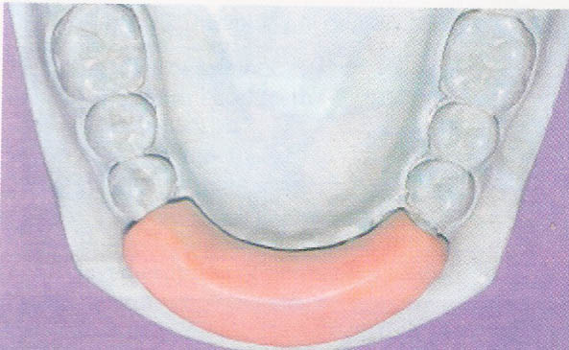
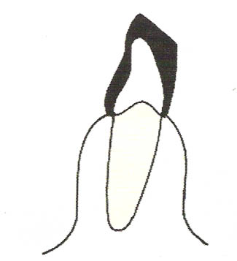
Drawbacks of using tongue blade
Only effective till the clinical crown not completely erupted in the oral cavity.
Used only if sufficient space is available for the correction.
Patients cooperation is required.
(2) Catlan’s appliance or lower anterior inclined plane
Indications
- Used only in those cases where the cross bite is due to a palataly placed max incisors.
(Constructed at 45⁰ angulations on the lower anterior teeth by acrylic or cast metal).

Slide 25
Disadvantages of Catlan’s Appliance
Difficulty in speech & chewing
Patient cooperation required
Require frequent recementation
Catlance appliance also as a anterior bite plane
Prevent the posterior teeth from coming into contact
If prolonged use
Supra eruption of posterior teeth
Anterior open bite
5) Can not be given if
Mandibular incisors are malaligned
Mandibular incisors are periodontally compromised

Slide 26
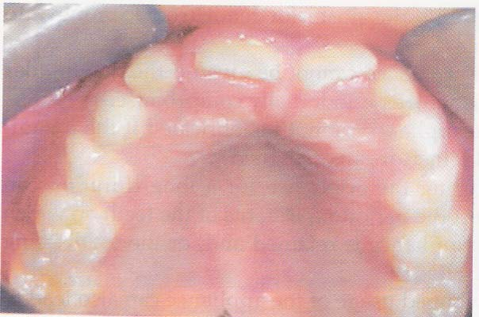
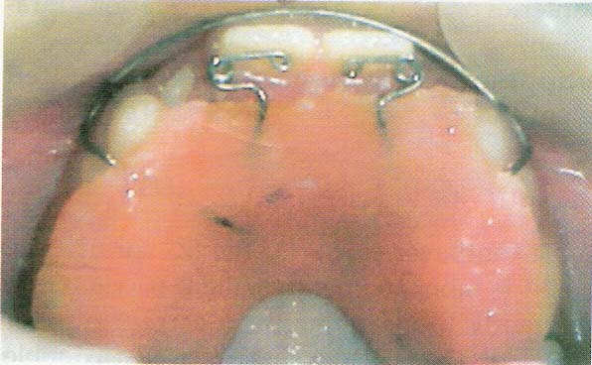
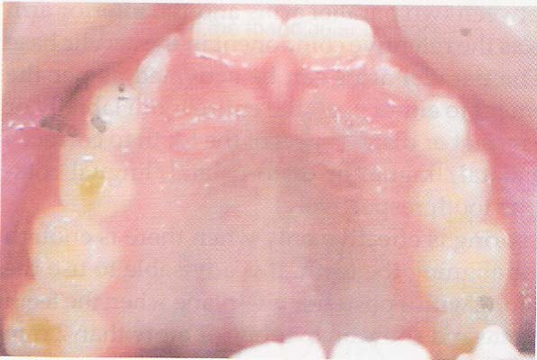
[3] Double cantilever spring / z-spring
Indication
Used when anterior cross bite involving 1 or 2 max. anterior teeth.
Disadvantage
Effective only when there is enough space for aligning the teeth.
Pre-treatment
During treatment
Post-treatment

Slide 27
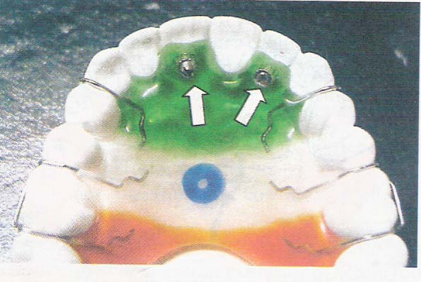
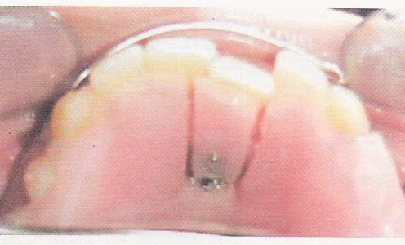
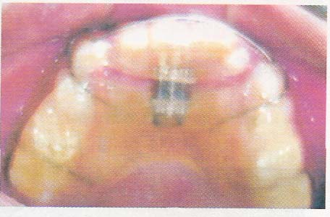
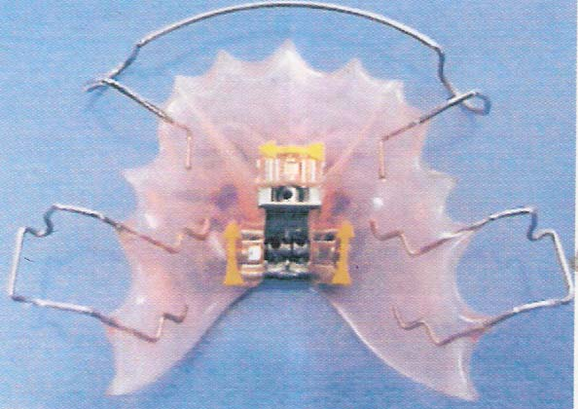
(4) Screw appliance
Micro screw
Used on individual tooth
Multiple micro screw can be used to correct individual tooth in segmental cross bite
(ii) Mini screw
Capable of moving up to 2 teeth
(iii) Medium screw
Used to correct segmental cross bite
(iv) 3-D screw (3-dimensional screw)
Capable of correcting posterior as well as anterior cross bite

Slide 28
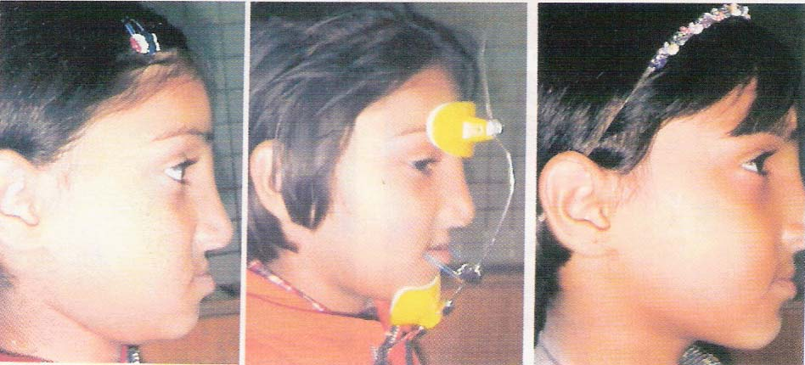
[5] Face mask (or face mask along with RME)
Indications
- Used to correct skeletal anterior cross bite (Anterior cross bite due to actual skeletal deficiency of the maxilla
Protraction face mask or Reverse head gear
If maxilla is narrow
RME screw also used for transverse expansion.

Slide 29
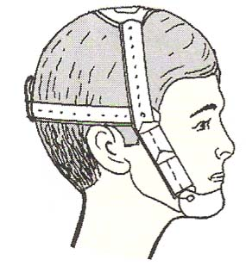
[6] Frankel III appliance
Used to correct skeletal class III Malocclusion.
[7] Chin cap appliance
Used to correct or prevent the anterior cross bite due to a prominent mandible.
Chin cap appliance rotate mandible backward and downward.

Slide 30
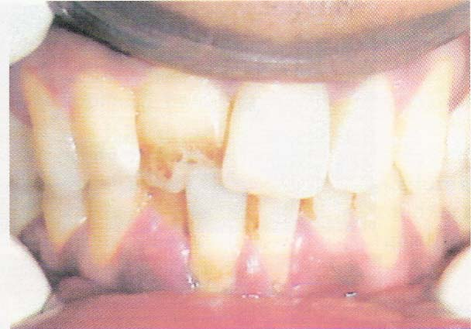
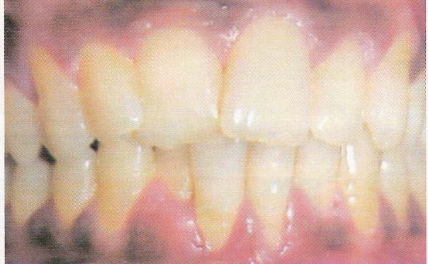
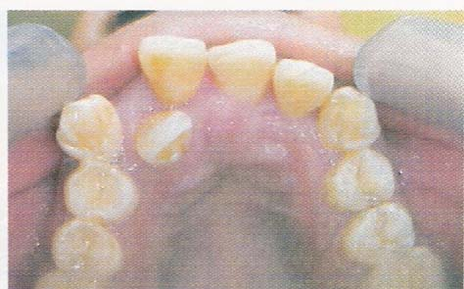
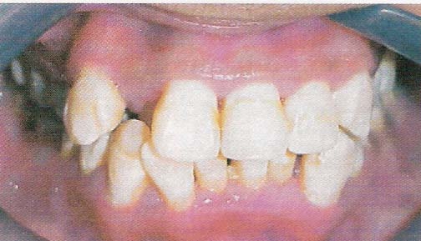
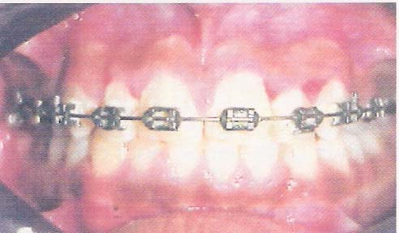
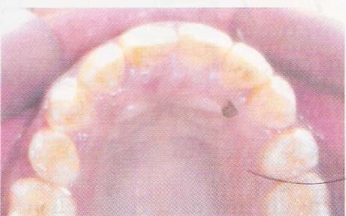
[III] IN PERMANENT DENTITION (In Adolescent & Adult)
Screw appliance
Mini screw May be used to correct single
Medium screw tooth or segmental cross bite.
Adequate space is required to correct the anterior cross bite
Otherwise results will be compromised
(2) Fixed Appliance
Used to correct single tooth or multiple tooth
[IV] IN POST PERMANENT DENTITION
Surgical orthodontist
(After the active growth is complete)

Slide 31
Factors influencing the treatment of posterior crossbite
Buccolingual tooth inclination
Etiology
Vertical changes

Slide 32
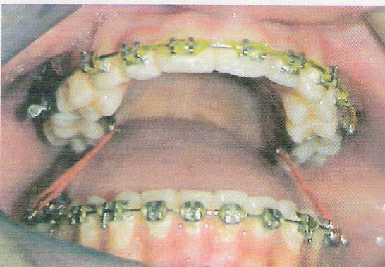
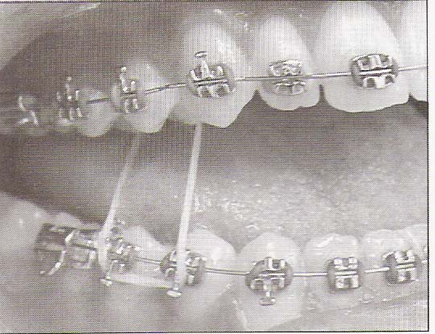
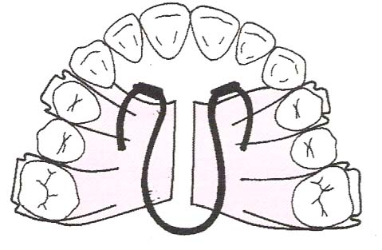
[B] MANAGEMENT OF POSTERIOR CROSS BITE
[1] CROSS BITE ELASTICS
Indication
Single tooth cross bite involving molars can be treated by elastics
Elastics are stretched b/w the max palatal surfaces and mandibular buccal surface.
[Worn day & night & treatment should not be continued for more than a weeks because elastics can extrude the teeth].
[2] COFFIN SPRING
Omega shaped wire appliance is capable of correcting cross bite in the young developing dentition.
Expansion produced is slow & bilaterally symmetrical.

Slide 33
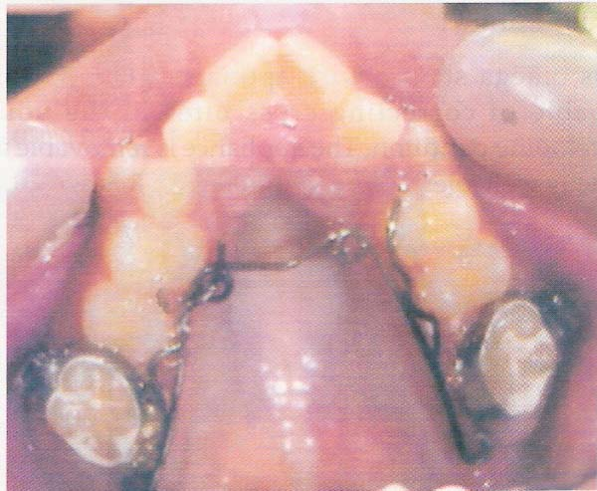
[3] QUAD HELIX APPLIANCE
A spring that consists of 4 helices
Being soldered to the molar bands that are commented generally on the first permanent max. molars.
Capable of dentoalveolar expansion of the molar as well as premolar region (slow expansion).
It can be reactivated by 3 prong wires without having to be removed.

Slide 34
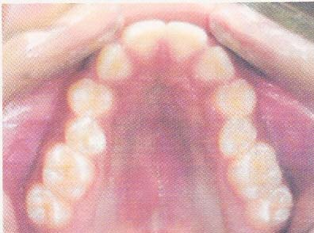
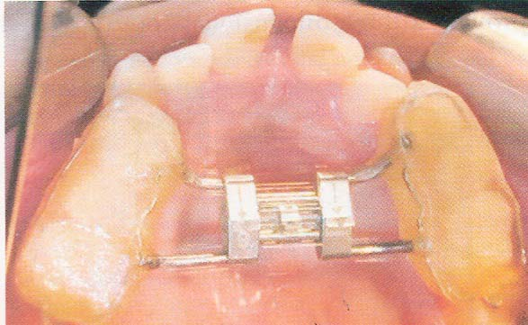
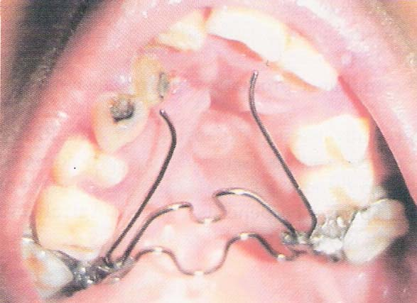
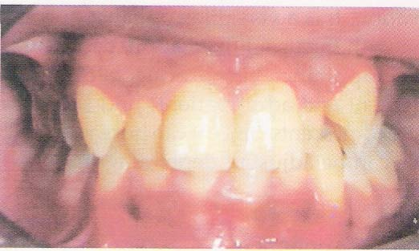
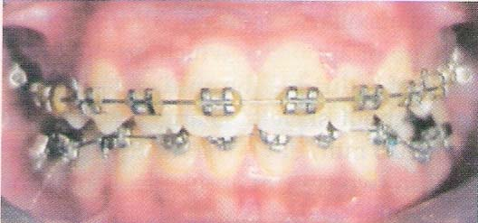
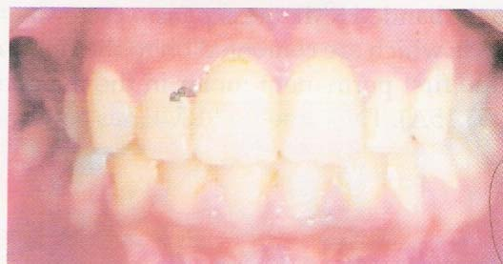
(4) R.M.E.
Hyrax screw
(5) NiTi expanders
Nickel titanium wire shapes
Welded to molar bands that are cemented to the maxillary permanent molars
NiTi expander place in a cleft case
(6) Fixed orthodontic Appliance
Used for correction of posterior cross bite

Slide 35
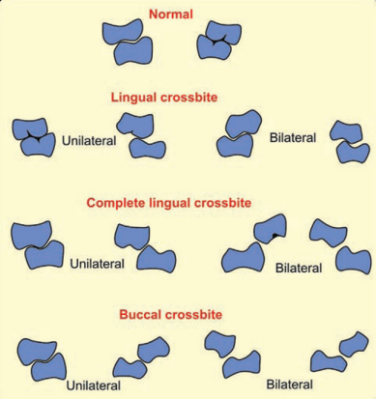
Summary
Types of crossbite:
Anterior crossbite: (i) single tooth, and (ii) multiple teeth or segmental.
Posterior crossbite: (i) unilateral, (ii) bilateral, and (iii) single tooth crossbite.
Crossbite Types:
Dental: (i) anterior, and (ii) posterior
Skeletal: (i) anterior, and (ii) posterior
Functional crossbite:
- Anterior crossbite
Buccal crossbite
Lingual crossbite
Scissor bite / Telescopic bite
Reverse telescopic bite

Slide 36
REFERENCES
Textbook of Orthodontics – Gurkeerat Singh, Jaypee Brothers; 2nd Edition
Orthodontics – The Art and Science, S.I Bhalajhi, AryaMedi Publishing; 7th Edition
Textbook of Orthodontics – Sridhar Premkumar, Elsevier; 1st Edition
Orthodontics: Diagnosis and Management of Malocclusion and Dentofacial Deformities – O.P Kharbanda, Elsevier; 1st Edition

Slide 37
Question & Answer Session

